Slide 1


Training the trainers:
some lessons learned
Joy Davidson
Digital Curation Centre

Slide 2

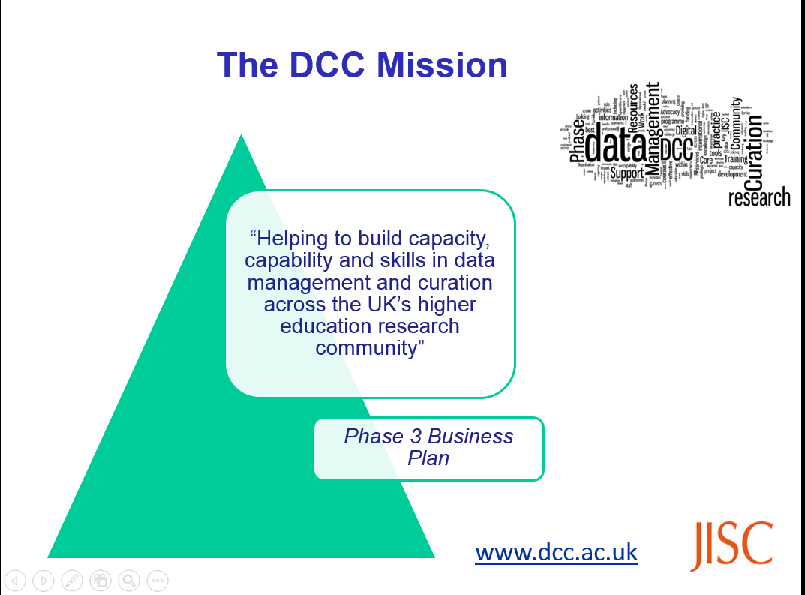
Background
Notes:
DCC has been around for 11 years. Training has always been a core activity. More recently, as a core partner in this FP7 project.
Through DCC core activity and our project work with FOSTER and 4C, we ran approximately 60 training in 2014-15 events and trained about 3500 participants (UK, EU, US, Africa)
Jisc RDM Readiness workshop - February 13 2015
Workshop considered challenges in meeting the EPSRC policy framework and included aa breakout on training approaches

Slide 3
What is the national picture in the UK?
Policy and strategy – 87%
Business planning – 13%
Data Management Planning – 50%
Data cataloguing – 38%
Managing active data – 40 %
Data preservation – 18%
Governing access & reuse – 22%
Skills training & consultancy – 63%
% indicating ‘rolling out’ or ‘embedding’
Notes:
The 2015 DCC survey collected responses from 60 institutions mapped to the DCC RDM services model.
You’ll notice that training underpins the more technical infrastructure requirements in the centre which as based around the data lifecycle.
Majority of UK HEIs making good progress in developing training and guidance. Longer term preservation and business case development are proving more difficult across UK HEIs. These will have an impact on training provision as well.

Slide 4
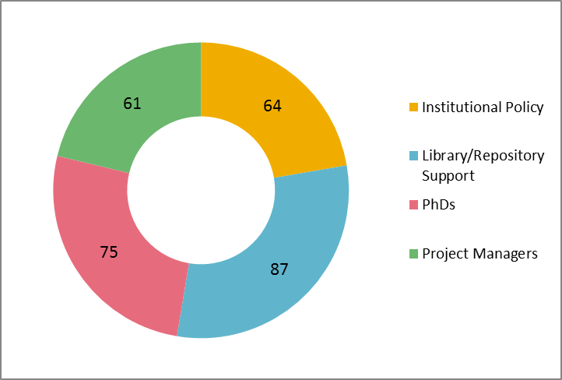
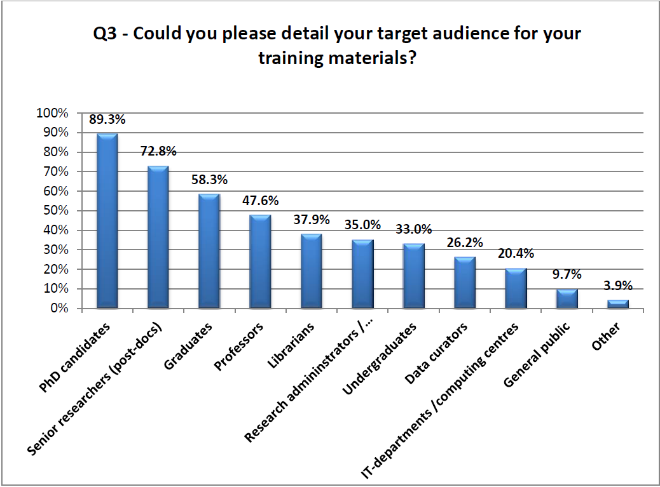
Who are we training?
Library staff
Research administrators
IT staff
Project officers (e.g., European Commission)
Resources by Audience
FOSTER landscape analysis
KE workshop Survey results
Notes:
There is a lot of train the trainer activity under way to target:
Librarians, research administrators and IT targeted but majority of training targeted towards researchers.
As part of our FOSTER activity, we carried out a landscape study of existing training materials and activity.
There was a very good split of resources identified across our four key target groups. We identified a slightly higher number of resources targeted to Libraries/Repository Support staff which is beneficial as in most cases it is this group that will be responsible for providing training to staff and students within European HEIs. Interestingly, most of the resources identified were applicable to more than one target audience which means that with slight revisions, the materials should be widely applicable for reuse.

Slide 5
So, a lot of groups are being targeted… but who is missing?
Archivists and records management team
Finance team
Legal office
DP/FoI
Ethics team
Discipline specific support (departmental or school level).
Notes:
Archivists and records managers - especially with regards to selection, appraisal and retention
Finance staff - costing RDM
Legal team - copyright and licensing
Ethics teams - there is a risk of disjoin between openness and data protection. Ethics panel members will need to have sufficient awareness of funders’ data sharing requirements and the potential benefits and impact for researchers.

Slide 6
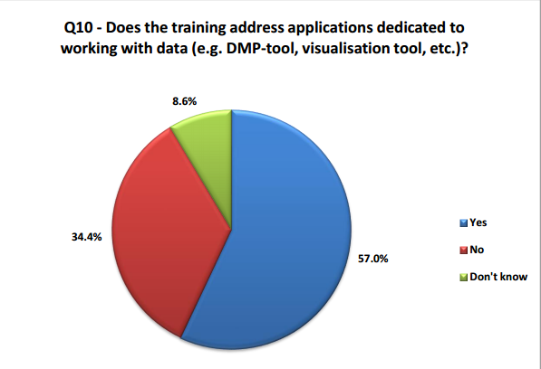
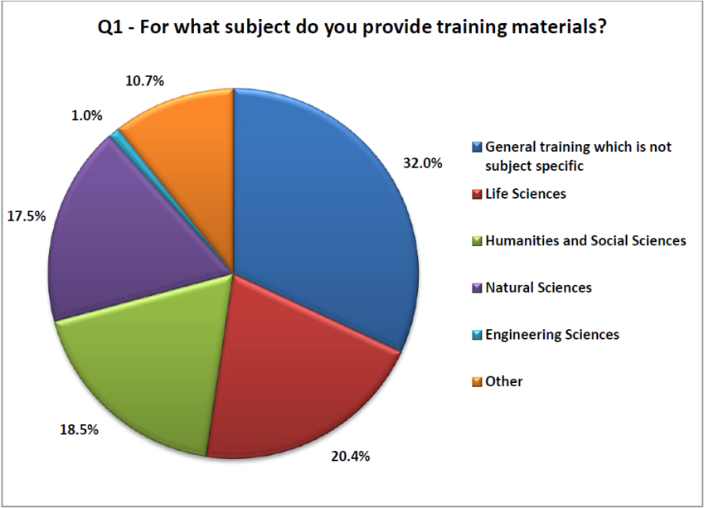
What are the topics being covered in training and at what level?
Entire lifecycle
Specific use of RDM tools (e.g., DMPonline)
Generic vs discipline specific
KE workshop Survey results
Notes:
There is a lot of train the trainer activity under way to target library staff, research office staff, IT staff and increasingly project officers from funding bodies.

Slide 7
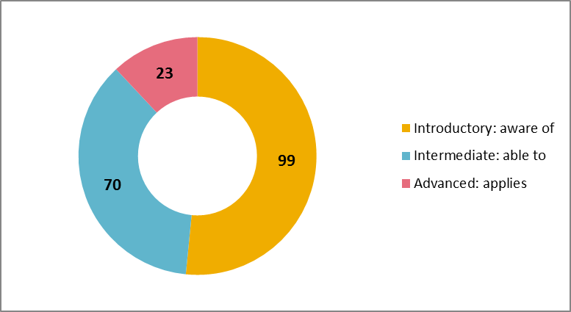
Gaps in coverage
Dealing with non-digital data
Training on costing RDM
Intermediate and advanced level training
Resources by Level of Knowledge
FOSTER landscape analysis
Notes:
Making sure that all data is adequately managed and linked – not just digital (e.g., core or tissue samples)
Costs – bear in mind curation cost coverage varies from council to council
Ensuring that trainers can progressively build up their expertise over time
Introductory level materials provide an awareness of key issues.
Intermediate level materials ensure that participants are able to do something particular after completing the course.
Advanced level materials ensure that those completing the course can apply their knowledge in their own particular setting.
The majority of the training resources identified by the FOSTER team fell with within the introductory or intermediate categories. We may seek to increase the level of advanced materials in years to come as the cohort of trainers become more skilled in dealing with RDM issues.

Slide 8
How big are institutional RDM teams?
Most HEIs have less than two dedicated staff members in data management posts
Posts spread across the institution (Library, IT,
Research Office).
Notes:
Based on RDM Readiness workshop breakout group on skills and training, we should bear in mind a few practical points.
Small teams are the norm. Makes it difficult to carry out day to day support and design and deliver training.
We need to be aware of these constraints and ensure that others across the institution are also involved in delivering training and not just those tasked with RDM duties. However, spread across HEI can make this time consuming and difficult.

Slide 9
Short term opportunities to explore
Reduce burden by blending general training from external providers (DCC, UK Data Service, FOSTER) with locale-specific information
Explore partnerships with European Research Infrastructures (e.g., ERICS) in developing discipline specific and infrastructure specific training
Buddying those just getting started with more mature institutions
Notes:
(local infrastructure, policies and support)
Buddying idea proposed by DCC colleague Laura Molloy (2015)

Slide 10
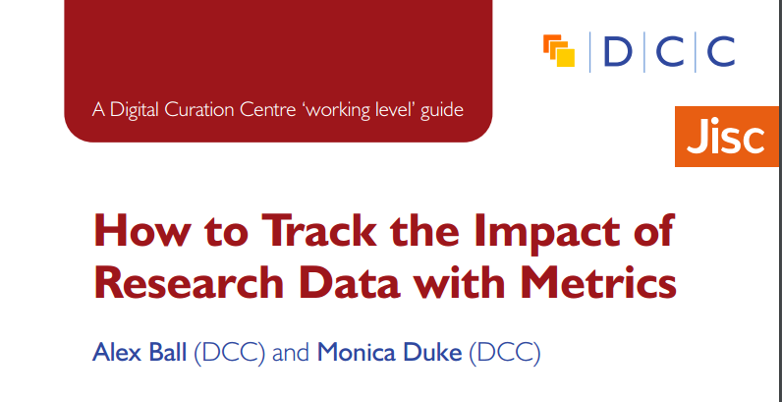
Longer term: define how to measure success
http://www.dcc.ac.uk/resources/how-guides/track-data-impact-metrics
How can we assess impact our training?
Notes:
There has been quite a bit of thinking around measuring the impact of research data.
However, as RDM infrastructure is defined and rolled out across the sector, we’ll need to consider collectively how we assess the performance of RDM services like training - both for trainers themselves and those they go on to train.

Slide 11
Benefits
Compliance with external funding bodies mandates but also…
Systems and support that are utilised and relevant to researchers’ needs
Better and more reproducible research
More visible research outputs and increased impact
Easier reporting through more joined up systems and processes

Slide 12
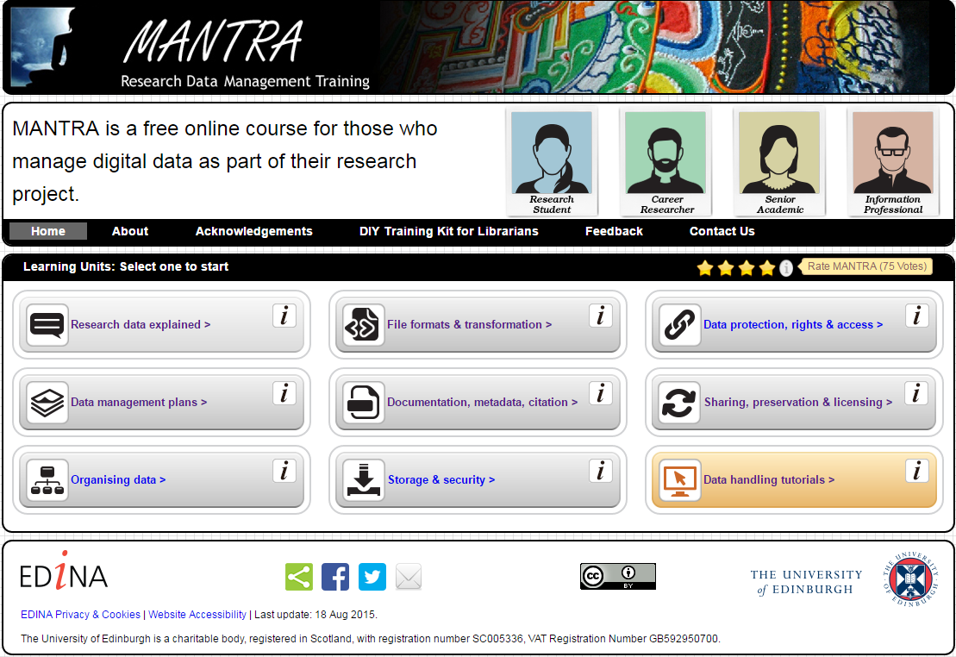
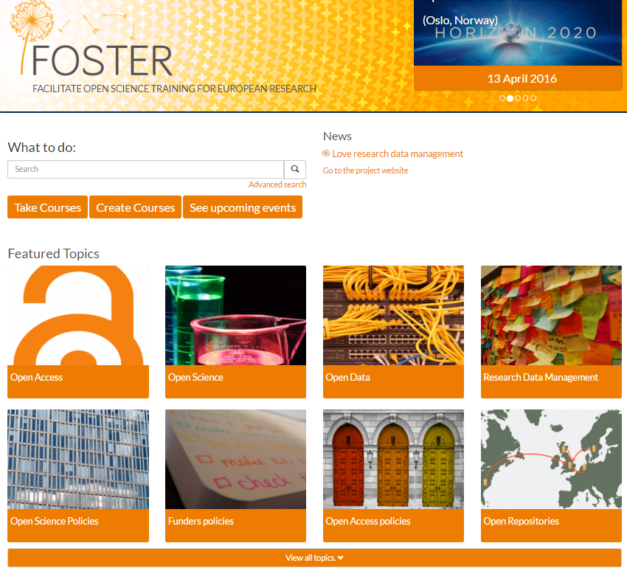
Guidance and training
http://datalib.edina.ac.uk/mantra/
https://www.fosteropenscience.eu/
Notes:
Remember to underpin your policy with guidance and training. The best systems and policies in the world are useless if researchers don’t know how and when to use them!
Make online training easily available – try to post support pages in places researchers can find them and pitch the guidance at the right level. At the University of Glasgow, the Incremental project pulled together details of existing support available. We included contact details so there were no dead ends.
In most cases, there will be a lot of existing guidance and support materials that can be adapted rather than creating new guidance from scratch. There are many examples of guidance and training – most are Creative Commons licensed so you can repurpose them.
New RDM Collection within Jorum.

Slide 13
Thanks – any questions?
joy.davidson@glasgow.ac.uk
@jd162a
www.dcc.ac.uk
Notes:
A quick summary of some of the key lessons we’ve learned through the work of the DCC over the past few years.

